Slide 1
Crop Production Analysis
An Analysis of Seasonal and State-wise Crop Production (1997-2015)
Prepared By :- Shaikh Minhazuddin

Slide 2
Objective
To understand the distribution and trends of crop production across different seasons and states in India from 1997 to 2015.
Insights from the analysis can support policymakers, farmers, and agricultural planners in making data-driven decisions.

Slide 3
Details of Data
Number of seasons.
Total crop variety.
Total production.
Number of districts involved in crop production.
State of Production
Area of Production
and various other necessary field.

Slide 4
Overall Crop Production
Seasons – 6 (Autumn, Kharif, Rabi, Summer, Whole Year, and Winter)
Total Crop Variety – There are total 124 distinct crop variety.
Total Production – 141.18 Billion Unit
Districts – 646 District were used for agriculture.

Slide 5
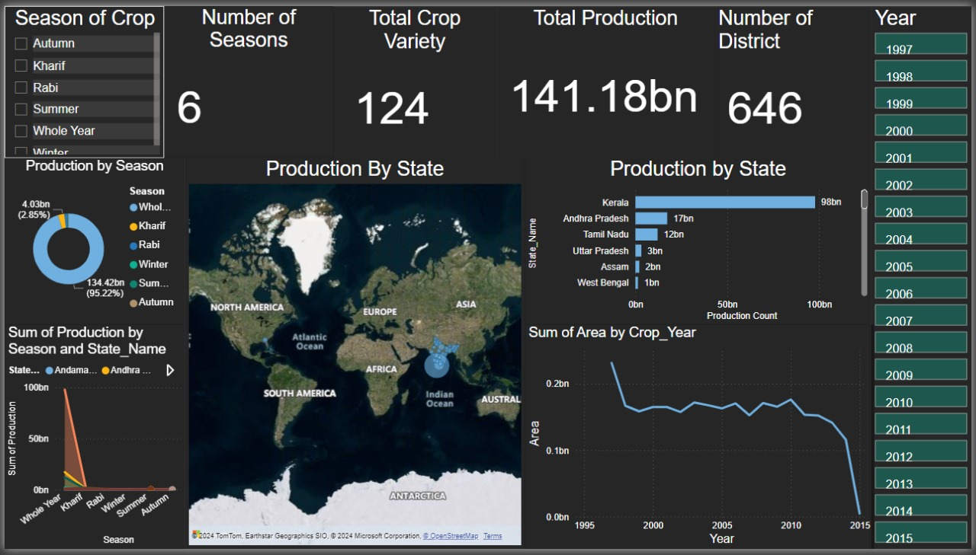
My Design

Slide 6
Thank you

